Slide 1
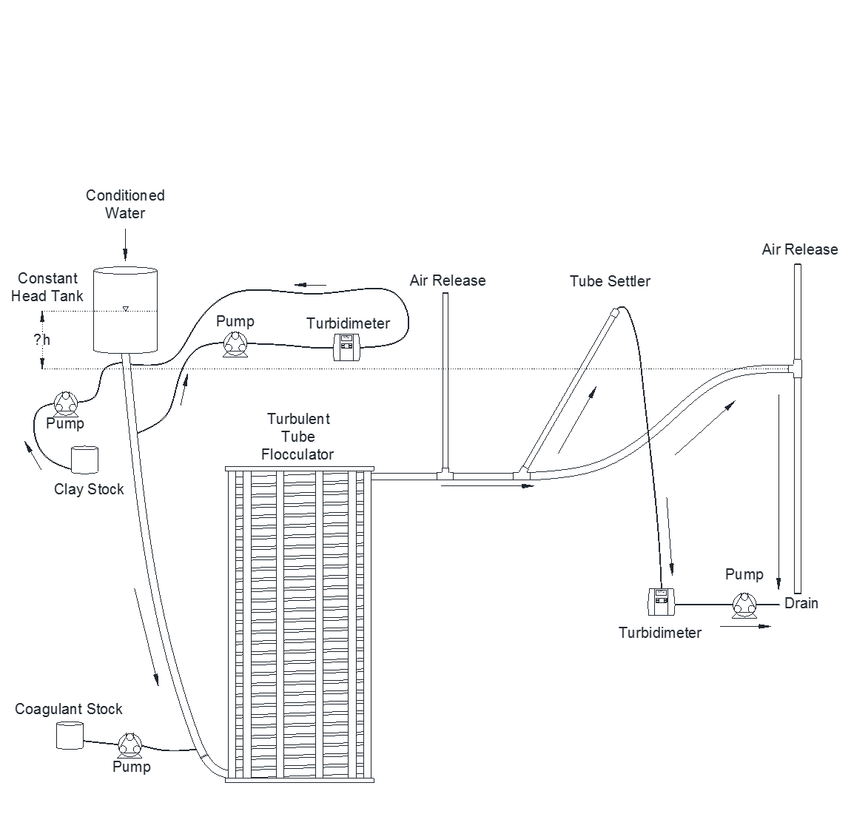
Design of the Turbulent Tube Flocculator
Presented by
William Pennock

Slide 2
Introduction
Me
Flocculation
You

Slide 3
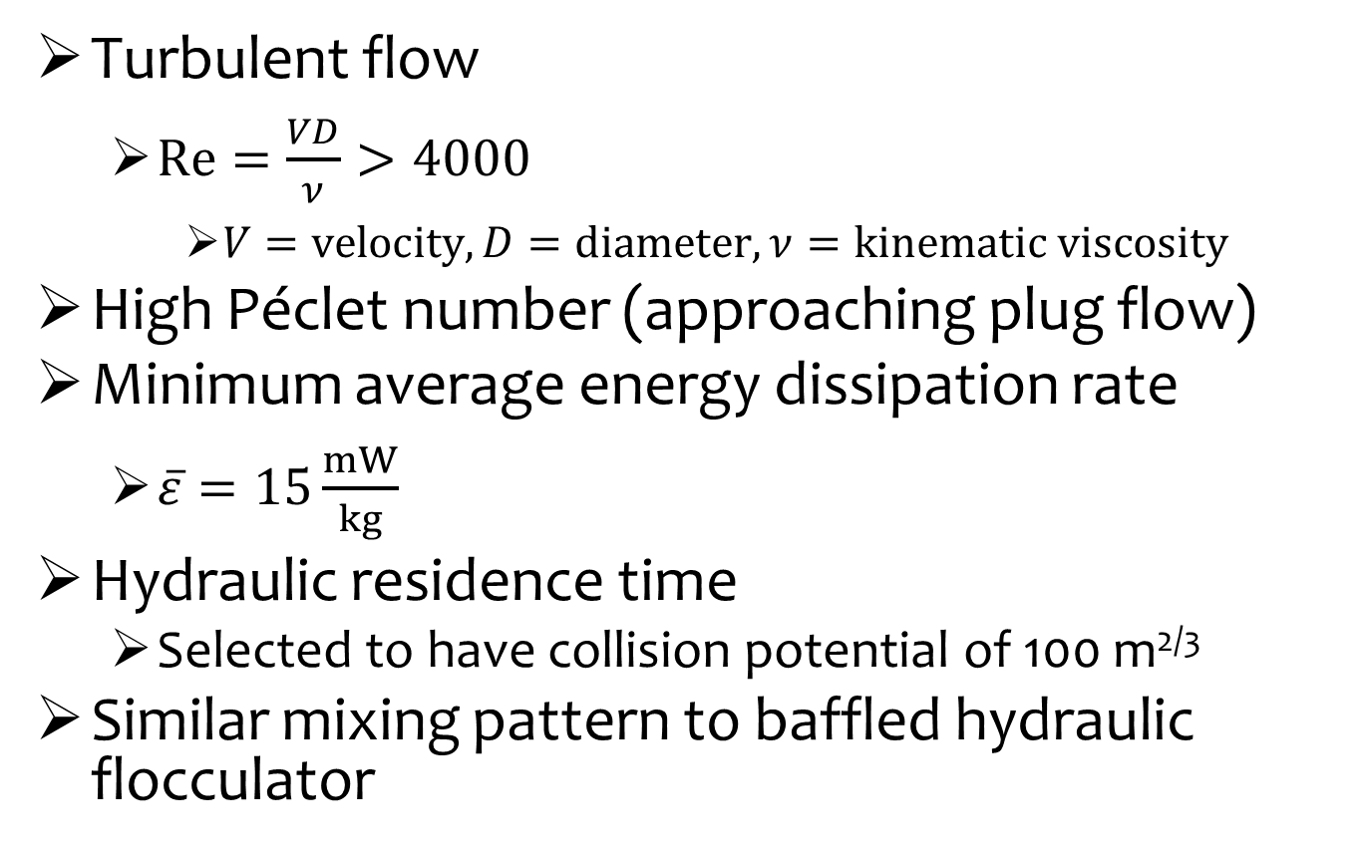
Design Objectives
Turbulent flow
$Re=\frac{VD}{ν}>4000$
$V=velocity, D=diameter, ν=kinematic viscosity$
High Péclet number (approaching plug flow)
Minimum average energy dissipation rate
$\overline{ε}=15\frac{mW}{kg}$
Hydraulic residence time
Selected to have collision potential of 100 m^{2/3}
Similar mixing pattern to baffled hydraulic flocculator

Slide 4
Design Concept

Slide 5
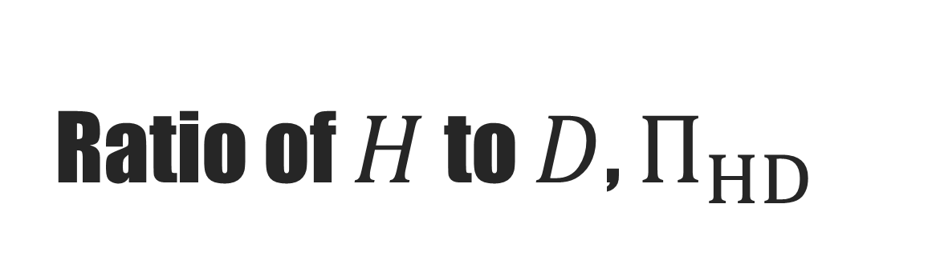

Ratio of $H$ to $D$, $Π_{HD}$
$$H$$
S
Notes:
Used 4.9

Slide 6
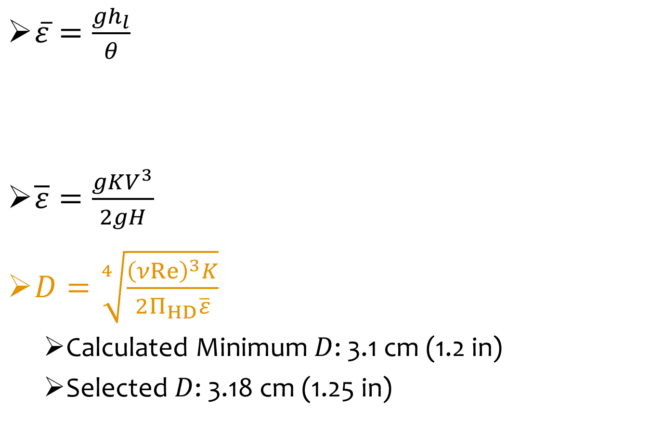

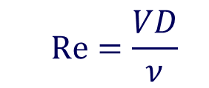
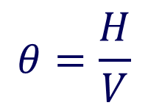
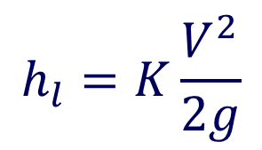
Setting $D$
$\overline{ε}=\frac{gh_{l}}{θ}$
$\overline{ε}=\frac{gKV^{3}}{2gH}$
$D=\sqrt[4]{\frac{{\left(νRe\right)}^{3}K}{2Π_{HD}\overline{ε}}}$
Calculated Minimum $D$: 3.1 cm (1.2 in)
Selected $D$: 3.18 cm (1.25 in)
$$h_{l}=K\frac{V^{2}}{2g}$$
$$θ=\frac{H}{V}$$
$$Re=\frac{VD}{ν}$$

Slide 7
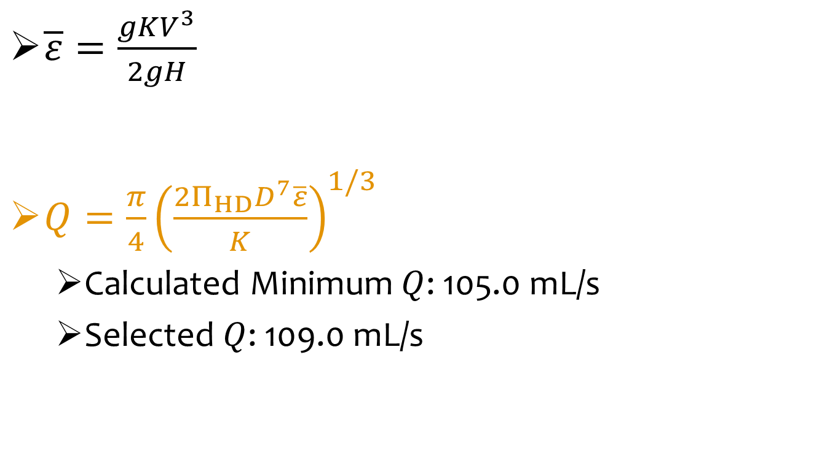

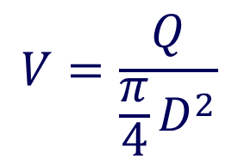
Setting $Q$
$\overline{ε}=\frac{gKV^{3}}{2gH}$
$Q=\frac{π}{4}{\left(\frac{2Π_{HD}D^{7}\overline{ε}}{K}\right)}^{1/3}$
Calculated Minimum $Q$: 105.0 mL/s
Selected $Q$: 109.0 mL/s
$$V=\frac{Q}{\frac{π}{4}D^{2}}$$

Slide 8

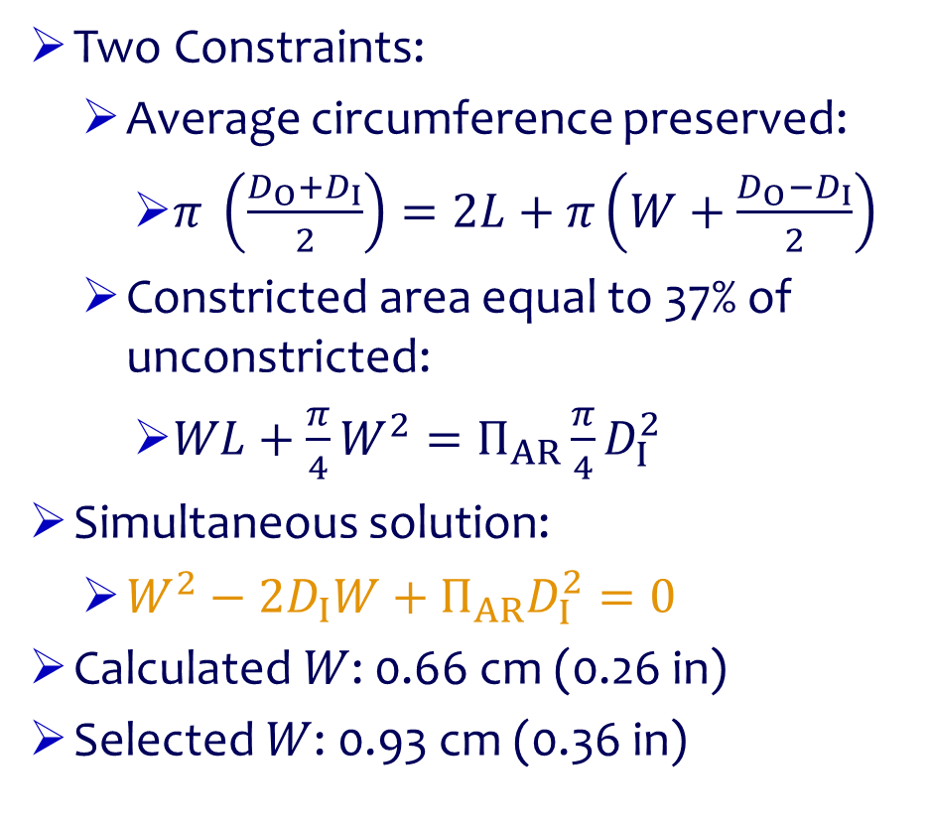
Setting Constriction Width, $W$
Two Constraints:
Average circumference preserved:
$π \left(\frac{D_{O}+D_{I}}{2}\right)=2L+π\left(W+\frac{D_{O}−D_{I}}{2}\right)$
Constricted area equal to 37% of unconstricted:
$WL+\frac{π}{4}W^{2}=Π_{AR}\frac{π}{4}D_{I}^{2}$
Simultaneous solution:
$W^{2}−2D_{I}W+Π_{AR}D_{I}^{2}=0$
Calculated $W$: 0.66 cm (0.26 in)
Selected $W$: 0.93 cm (0.36 in)

Slide 9
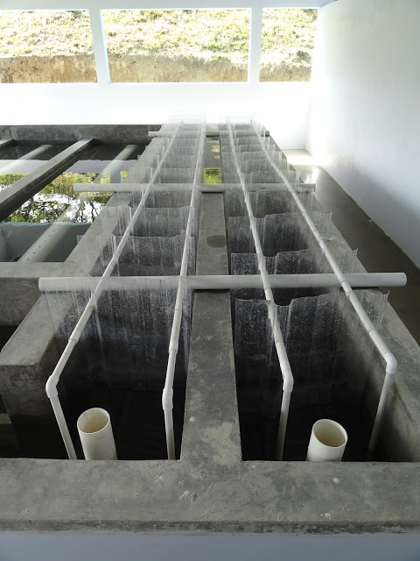
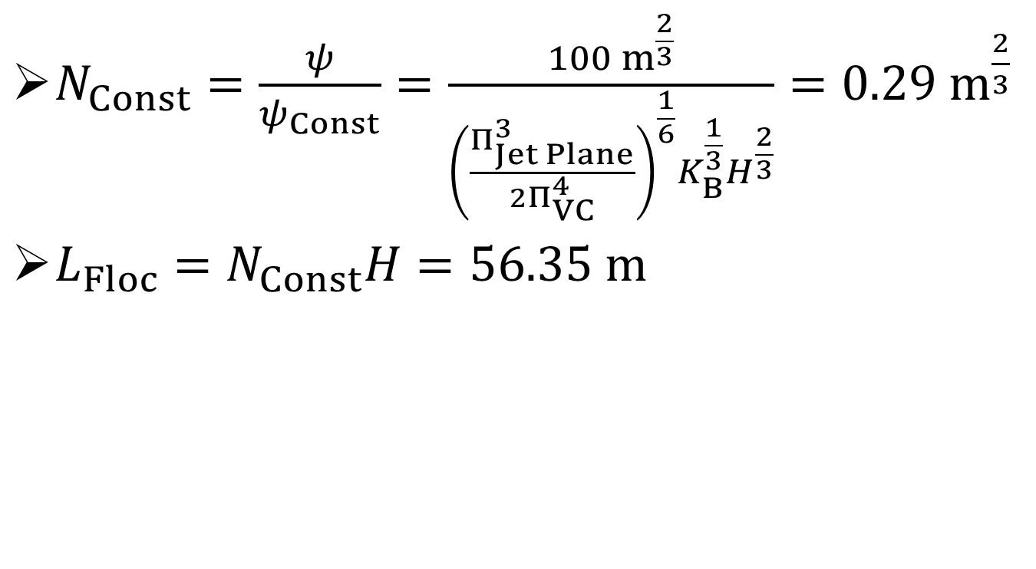

Setting $L$
$N_{Const}=\frac{ψ}{ψ_{Const}}=\frac{100 m^{\frac{2}{3}}}{{\left(\frac{Π_{Jet Plane}^{3}}{2Π_{VC}^{4}}\right)}^{\frac{1}{6}}K_{B}^{\frac{1}{3}}H^{\frac{2}{3}}}=0.29 m^{\frac{2}{3}}$
$L_{Floc}=N_{Const}H=56.35 m$

Slide 10
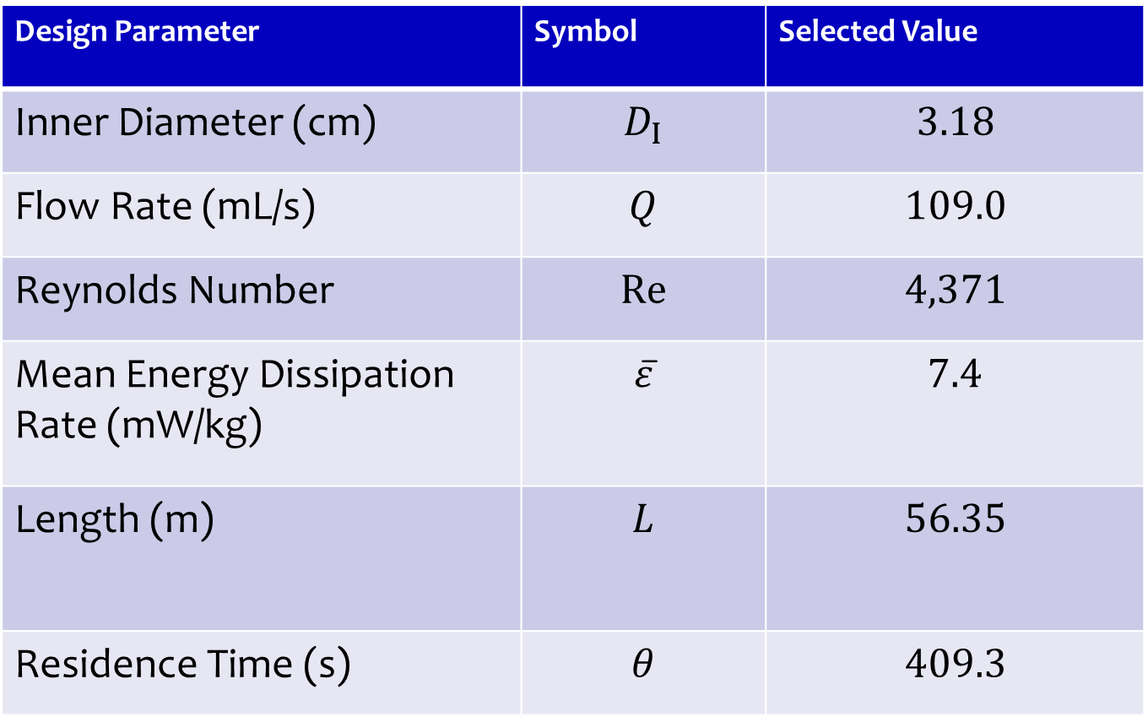
Final Design
Design Parameter | Symbol | Selected Value
Inner Diameter (cm) | $$D_{I}$$ | $$3.18$$
Flow Rate (mL/s) | $$Q$$ | $$109.0$$
Reynolds Number | $$Re$$ | $$4,371$$
Mean Energy Dissipation Rate (mW/kg) | $$\overline{ε}$$ | $$7.4$$
Length (m) | $$L$$ | $$56.35$$
Residence Time (s) | $$θ$$ | $$409.3$$

Slide 11
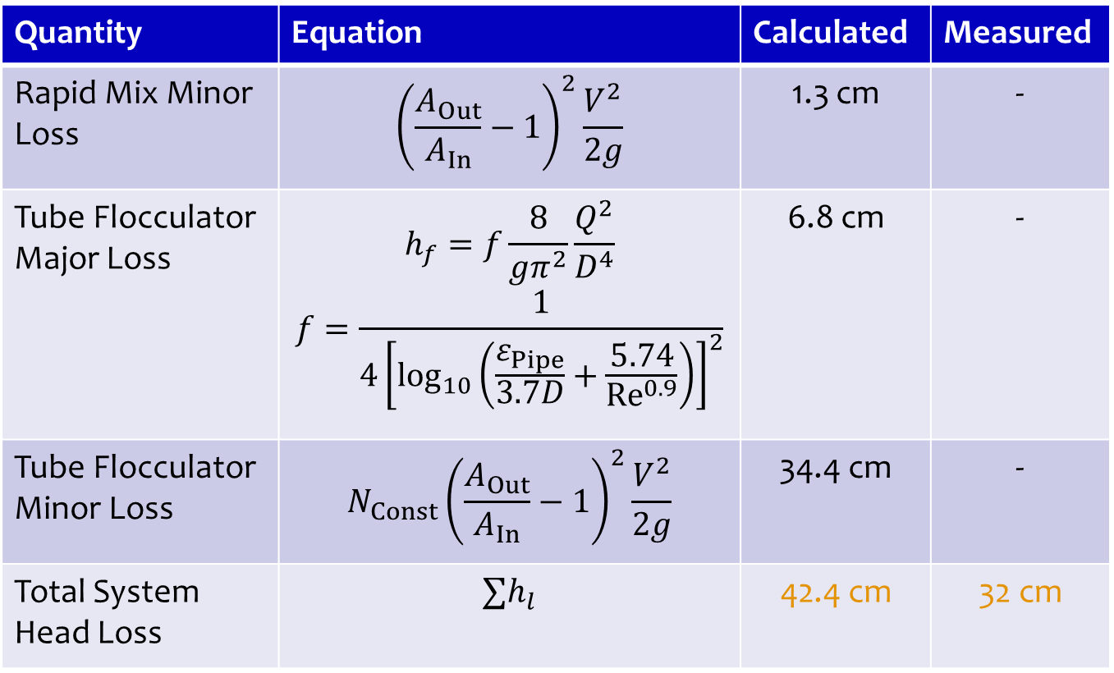
Verification of Design
Quantity | Equation | Calculated | Measured
Rapid Mix Minor Loss | $${\left(\frac{A_{Out}}{A_{In}}−1\right)}^{2}\frac{V^{2}}{2g}$$ | 1.3 cm | -
Tube Flocculator Major Loss | $$h_{f}=f\frac{8}{gπ^{2}}\frac{Q^{2}}{D^{4}}$$ $$f=\frac{1}{{4\left[\log_{10}\left(\frac{ε_{Pipe}}{3.7D}+\frac{5.74}{{Re}^{0.9}}\right)\right]}^{2}}$$ | 6.8 cm | -
Tube Flocculator Minor Loss | $$N_{Const}{\left(\frac{A_{Out}}{A_{In}}−1\right)}^{2}\frac{V^{2}}{2g}$$ | 34.4 cm | -
Total System Head Loss | $$∑h_{l}$$ | 42.4 cm | 32 cm

Slide 12
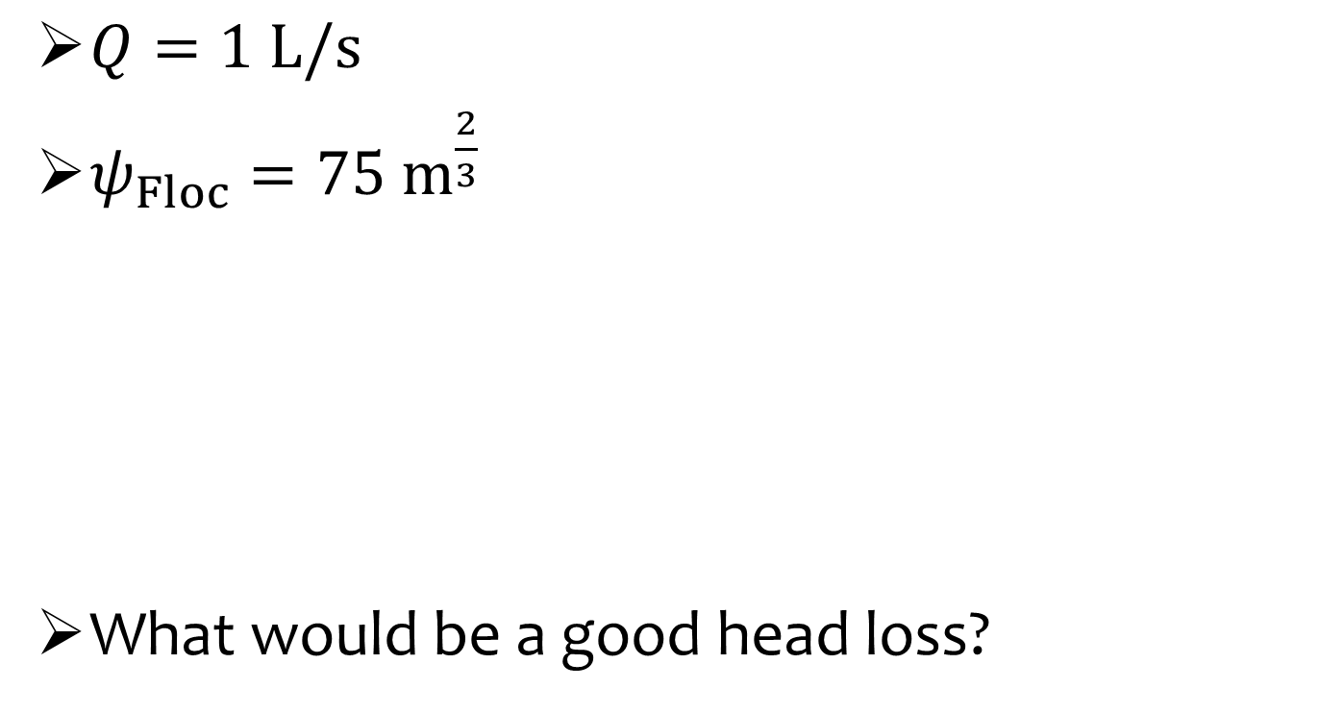
1 L/s Tube Flocculator Constraints
$Q=1 L/s$
$ψ_{Floc}=75 m^{\frac{2}{3}}$
What would be a good head loss?

Slide 13
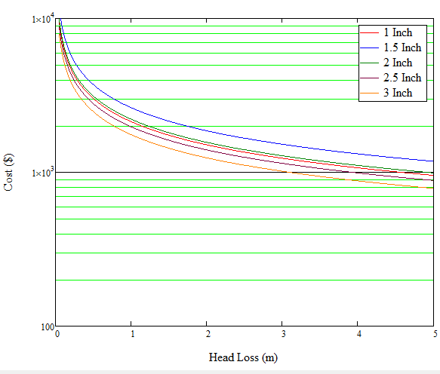
What Sets the Lower Bound for Head Loss?

Slide 14

What Sets the Upper Bound for Head Loss?
Pressure!
Max Pressure of 3 in Tubing = 10 psi (7 m)
Floc break-up!
http://stream1.gifsoup.com/view/784435/water-balloon-o.gif

Slide 15

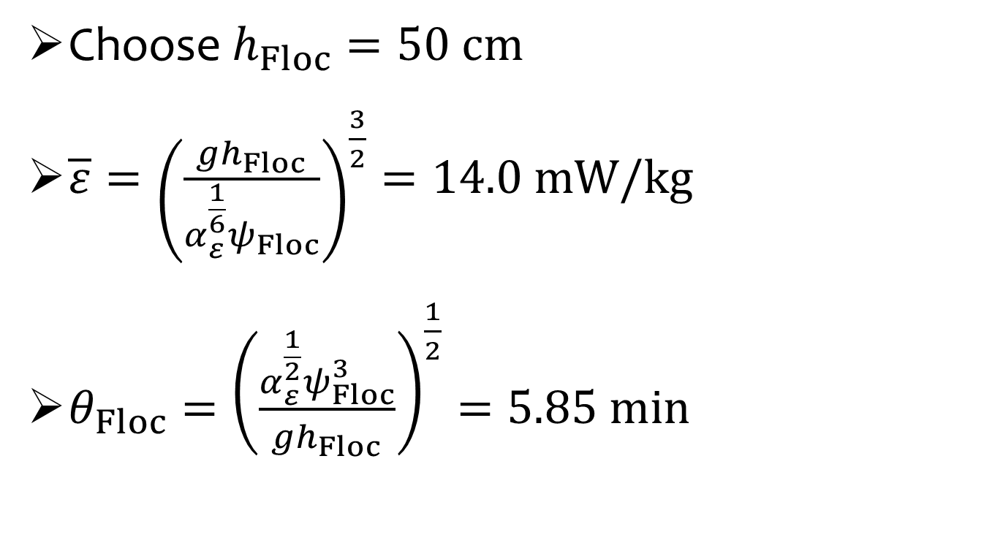
Solve for $\overline{ε}$ and $θ_{Floc}$
Choose $h_{Floc}=50 cm$
$\overline{ε}={\left(\frac{gh_{Floc}}{α_{ε}^{\frac{1}{6}}ψ_{Floc}}\right)}^{\frac{3}{2}}=14.0 mW/kg$
$θ_{Floc}={\left(\frac{α_{ε}^{\frac{1}{2}}ψ_{Floc}^{3}}{gh_{Floc}}\right)}^{\frac{1}{2}}=5.85 min$
Notes:
Usual range is 10 mW/kg

Slide 16
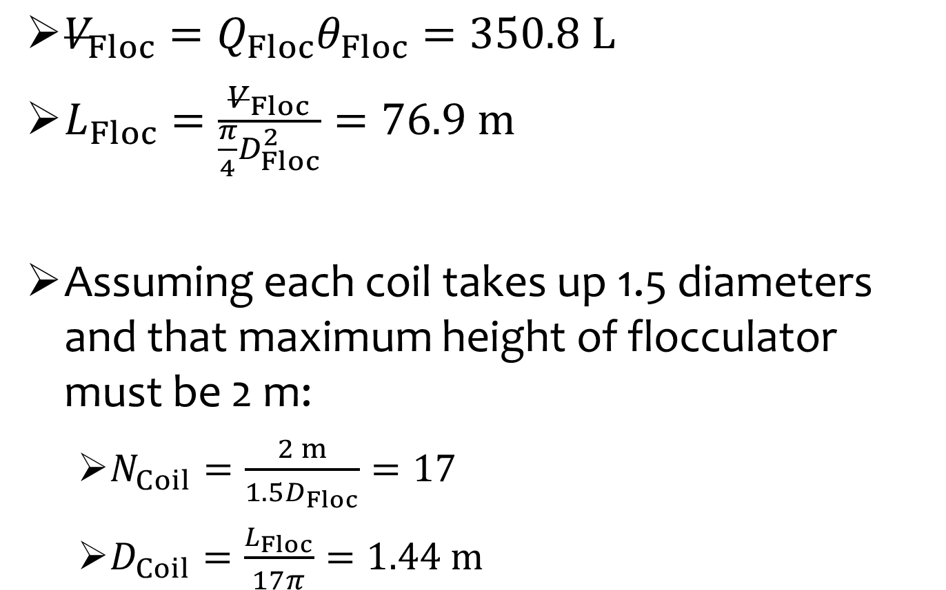
Flocculator Dimensions
$V_{Floc}=Q_{Floc}θ_{Floc}=350.8 L$
$L_{Floc}=\frac{V_{Floc}}{\frac{π}{4}D_{Floc}^{2}}=76.9 m$
Assuming each coil takes up 1.5 diameters and that maximum height of flocculator must be 2 m:
$N_{Coil}=\frac{2 m}{1.5D_{Floc}}=17$
$D_{Coil}=\frac{L_{Floc}}{17π}=1.44 m$
Notes:
Why set the maximum height at 2 m?
About 14 ft
Could store chemical stocks in here or put entrance tank here
What is missing in this design?

Slide 17
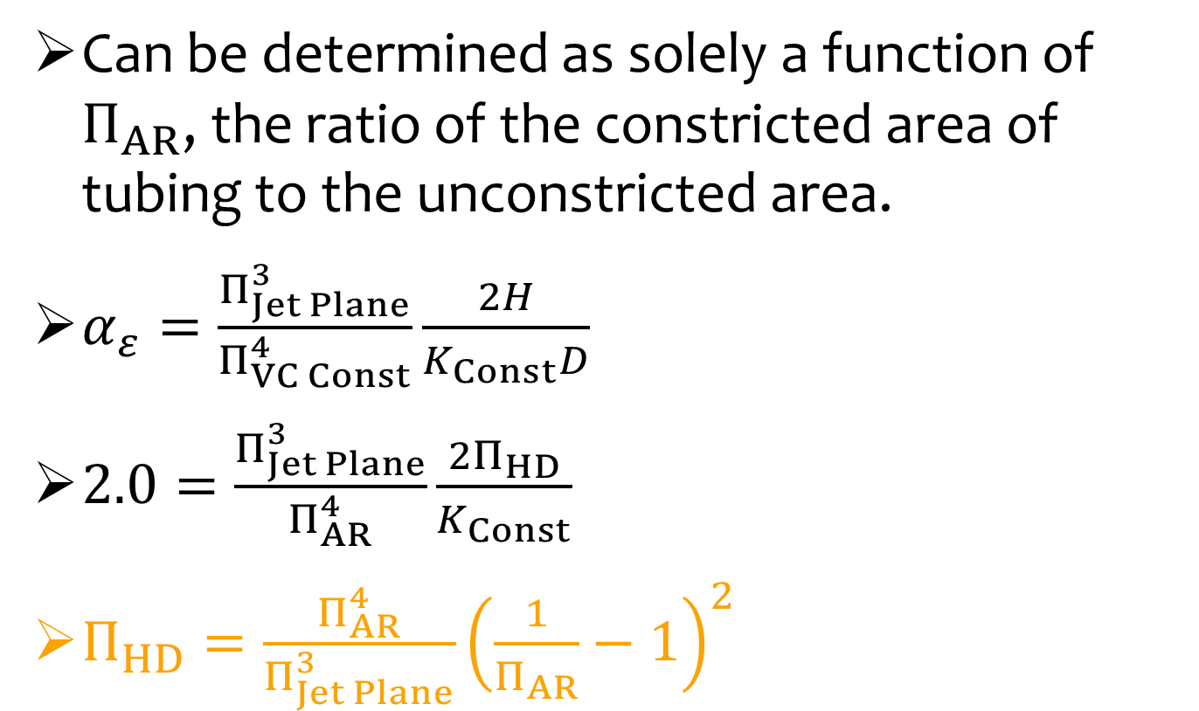
Choosing the Spacing Between Constrictions
Can be determined as solely a function of $Π_{AR}$, the ratio of the constricted area of tubing to the unconstricted area.
$α_{ε}=\frac{Π_{Jet Plane}^{3}}{Π_{VC Const}^{4}}\frac{2H}{K_{Const}D}$
$2.0=\frac{Π_{Jet Plane}^{3}}{Π_{AR}^{4}}\frac{2Π_{HD}}{K_{Const}}$
$Π_{HD}=\frac{Π_{AR}^{4}}{Π_{Jet Plane}^{3}}{\left(\frac{1}{Π_{AR}}−1\right)}^{2}$
H

Slide 18
Understanding Constriction Spacing
Notes:
Want spaced out so that design is cheaper and so as to not lose too much volume

Slide 19
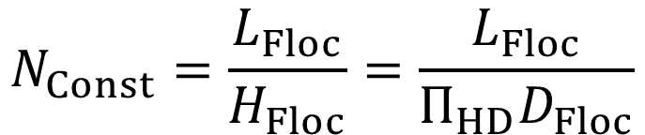
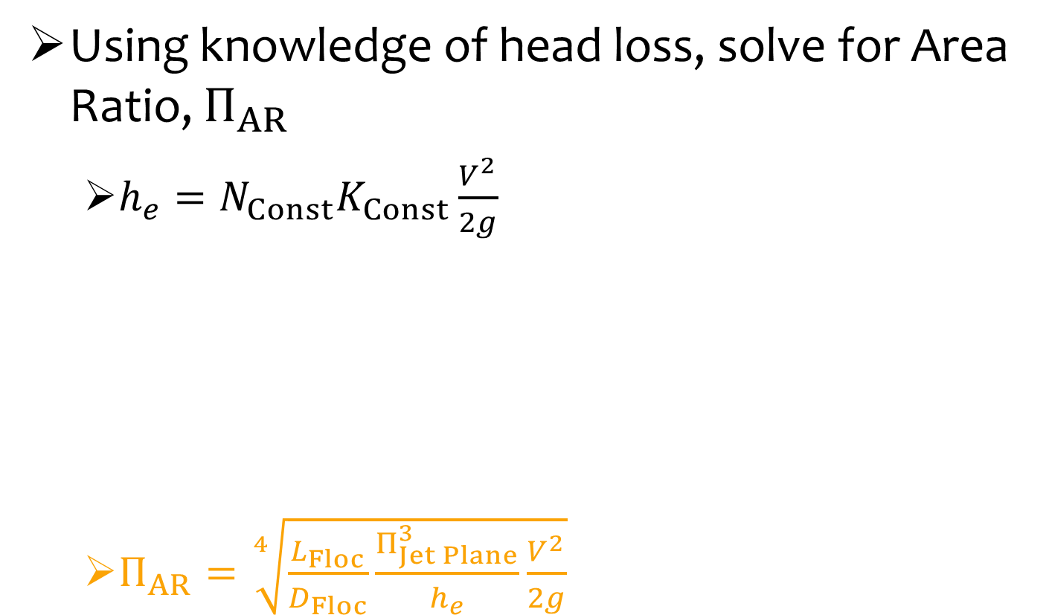
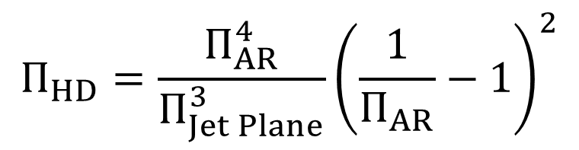
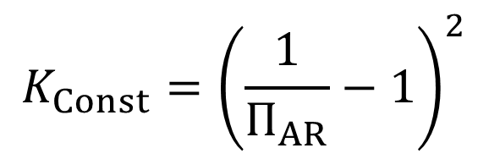
Deriving Area Ratio Formula
Using knowledge of head loss, solve for Area Ratio, $Π_{AR}$
$h_{e}=N_{Const}K_{Const}\frac{V^{2}}{2g}$
$Π_{AR}=\sqrt[4]{\frac{L_{Floc}}{D_{Floc}}\frac{Π_{Jet Plane}^{3}}{h_{e}}\frac{V^{2}}{2g}}$
$$N_{Const}=\frac{L_{Floc}}{H_{Floc}}=\frac{L_{Floc}}{Π_{HD}D_{Floc}}$$
$$K_{Const}={\left(\frac{1}{Π_{AR}}−1\right)}^{2}$$
$$Π_{HD}=\frac{Π_{AR}^{4}}{Π_{Jet Plane}^{3}}{\left(\frac{1}{Π_{AR}}−1\right)}^{2}$$

Slide 20
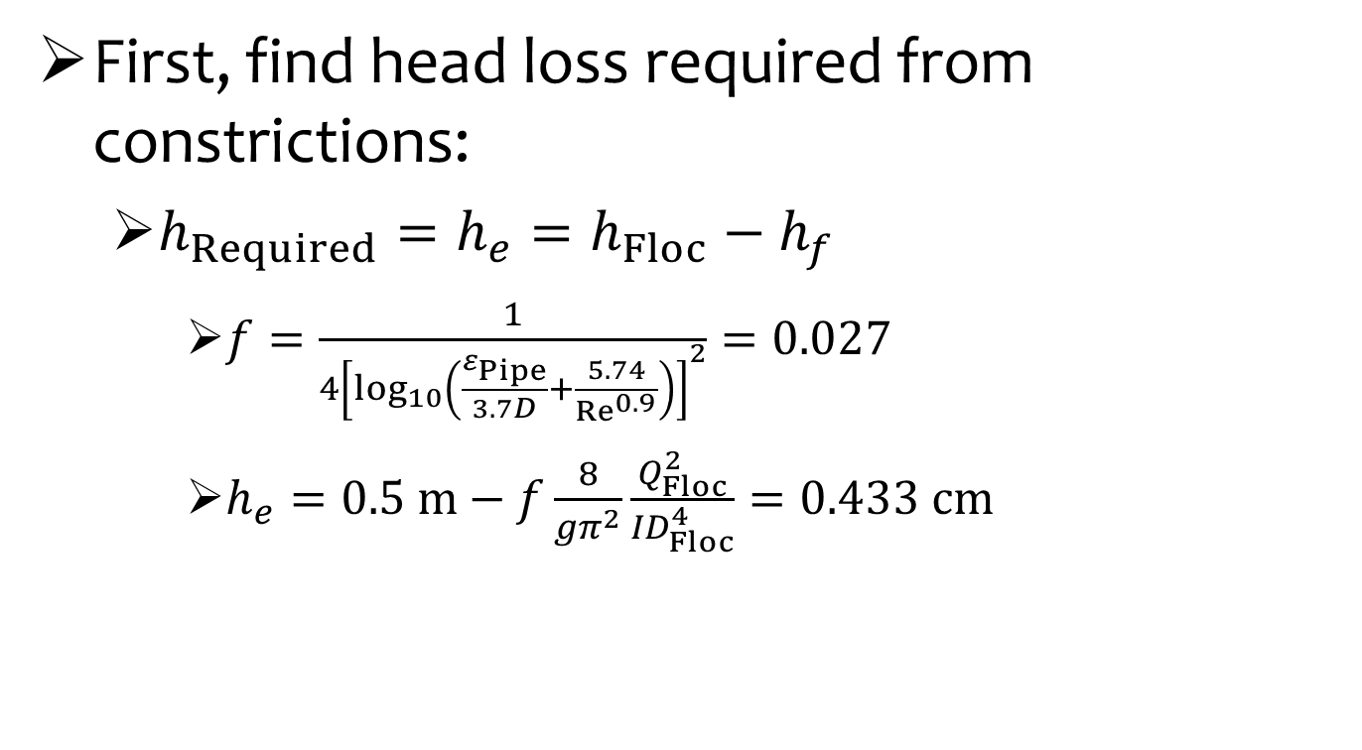
Determining Constriction Dimensions
First, find head loss required from constrictions:
$h_{Required}=h_{e}=h_{Floc}−h_{f}$
$f=\frac{1}{{4\left[\log_{10}\left(\frac{ε_{Pipe}}{3.7D}+\frac{5.74}{{Re}^{0.9}}\right)\right]}^{2}}=0.027$
$h_{e}=0.5 m−f\frac{8}{gπ^{2}}\frac{Q_{Floc}^{2}}{{ID}_{Floc}^{4}}=0.433 cm$

Slide 21
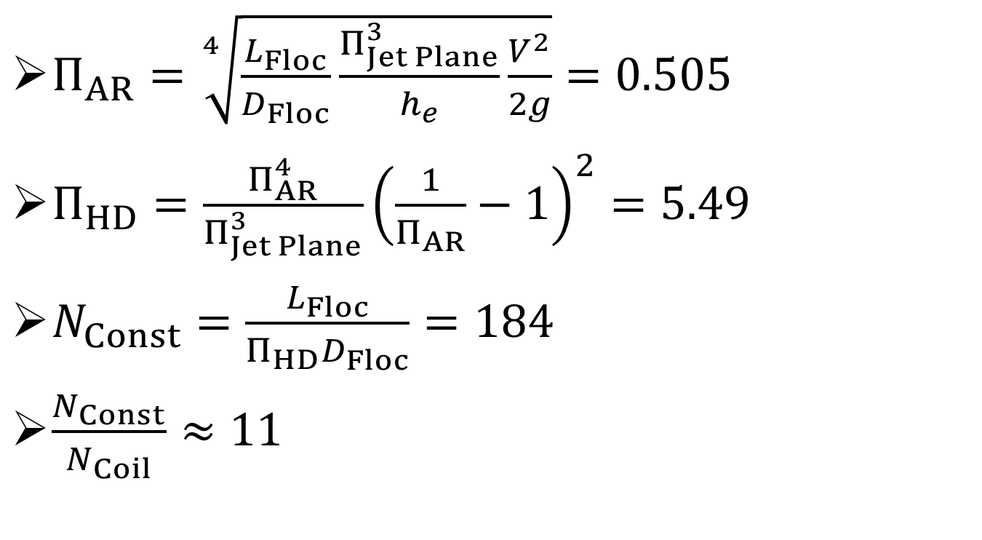
Constriction Dimensions
$Π_{AR}=\sqrt[4]{\frac{L_{Floc}}{D_{Floc}}\frac{Π_{Jet Plane}^{3}}{h_{e}}\frac{V^{2}}{2g}}=0.505$
$Π_{HD}=\frac{Π_{AR}^{4}}{Π_{Jet Plane}^{3}}{\left(\frac{1}{Π_{AR}}−1\right)}^{2}=5.49$
$N_{Const}=\frac{L_{Floc}}{Π_{HD}D_{Floc}}=184$
$\frac{N_{Const}}{N_{Coil}}≈11$
Notes:
Would need to have higher energy dissipation rate to have $Π_{AR}$ closer to optimum.

Slide 22
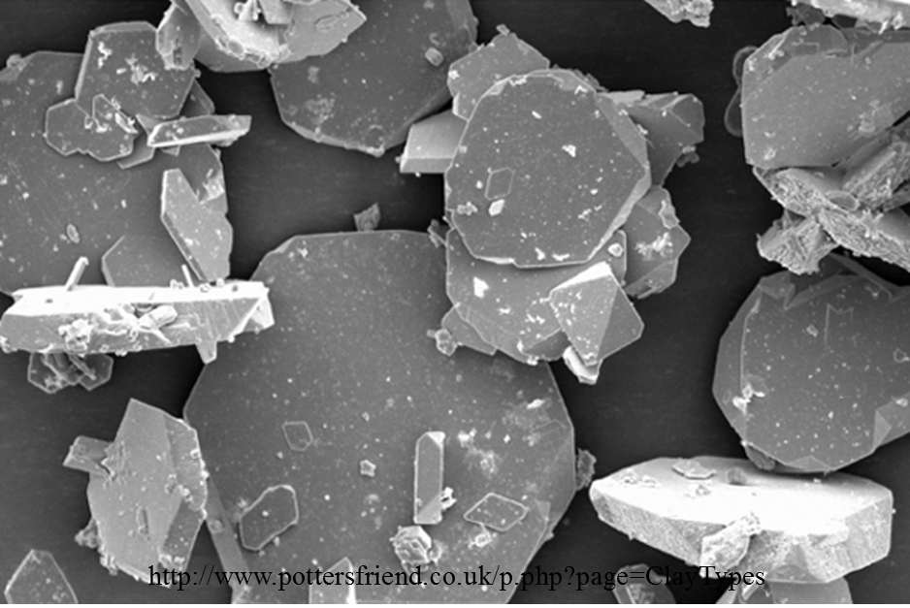
Questions?

